Slide 1
Web App Development 1.2
JavaScript Lab 1
Internal & External Javascript
Prompt() and alert()
CSS

Slide 2
Overview
This lab is designed to introduce you to the prompt() and alert() methods of JavaScript.
You will take data in from the user using prompts, then this information will be redisplayed to the user on the webpage by updating the DOM. Finally the user will be alerted to the fact that the web page has been modified. The following slides give this example:
The goal is to get three pieces of information from the user:
Their name. their age and their height in feet

Slide 3
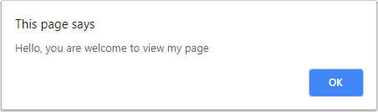
Question
Download and extract Root_JS.zip file from Moodle
Extract this file and rename the root folder JavaScript_Lab_1
Rename the HTML5 Template page to index.html
Open the index.html file in Chrome to see if it is successfully linking to the external JavaScript file. If it is you see an alert.

Slide 4
Question
Using your knowledge of headings and tables that you gained during the last semester, construct and render the webpage based on the image below:
Using the notes from the last class:
Modify the index file and add id attribute and attribute values to each cell where the user information must go, for example

Slide 5
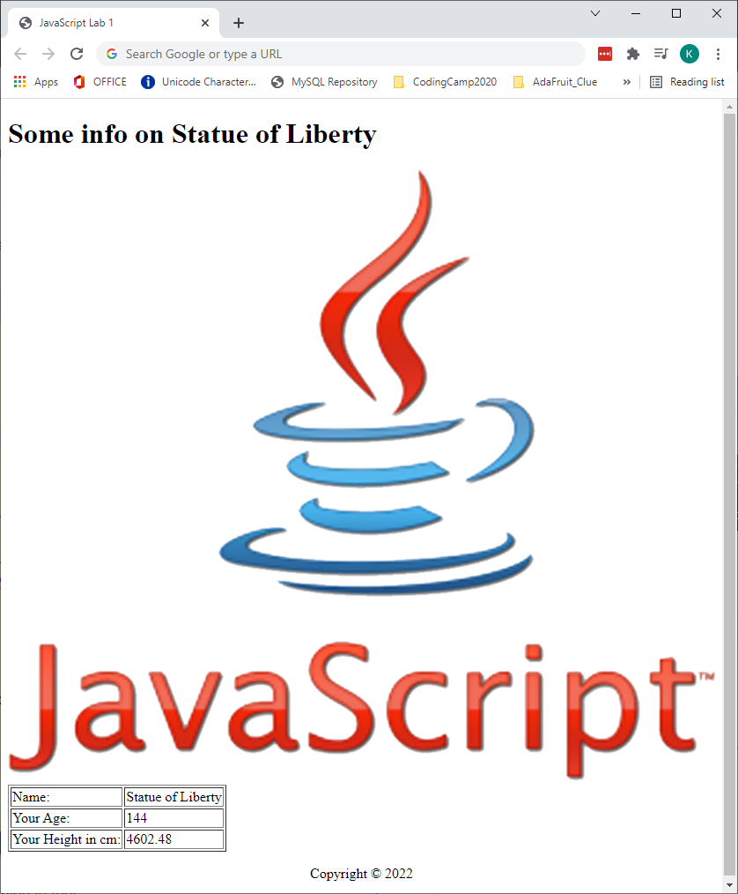
Web page without CSS & JavaScript

Slide 6
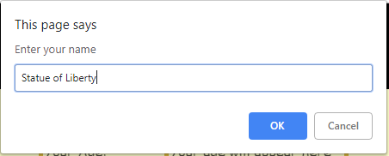
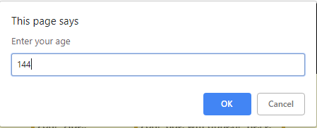
When page is loaded
The first prompt will ask for a name
The second prompt will ask an age

Slide 7
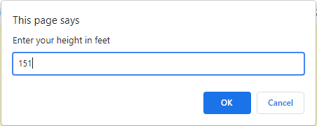
When page is loaded
The third prompt will ask for the users height in feet, when this value is accepted you must convert it to cm.
1foot = 30.48cm

Slide 8
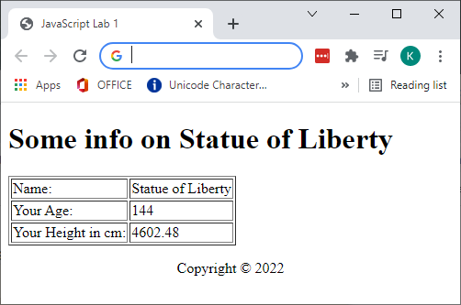
RESULT
As you can see from the screenshot the DOM is updated with the user information.
Note how the height of the user has been converted to feet:

Slide 9
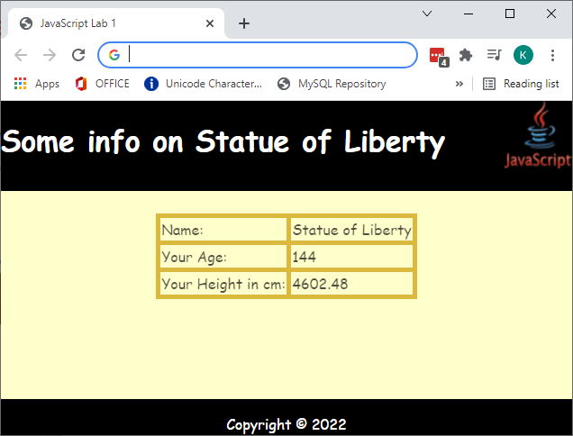
Finally Style the page as follows

Slide 10
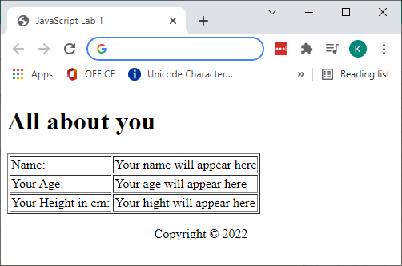
header element
id=“theTitle”
main element
id=“theName”
id=“theAge”
id=“theHeight”
footer element
There are three semantic elements on this page:
header – this is for the heading h1 at the top
main – this is where the table is inserted
footer – this is where the footer will go
Pay attention to the footer, this code was covered in the lecture”

Slide 11
Question
Open the myScript.js file that is located in the jScripts folder. This should be opened in NotePad++
Comment out the default alert() that is on line 1
Create a function called UpdateData()
Inside this function and using the notes from the last class:
Create 3 variables, name, height and age
Prompt the user for and save the input data into these variables
IMPORTANT: The user must be asked for their height in feet – you have to convert it to centimetres
1 Foot = 30.48 cm
NB: This is based on the final few slides of the last class

Slide 12
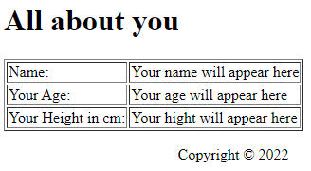

Slide 13
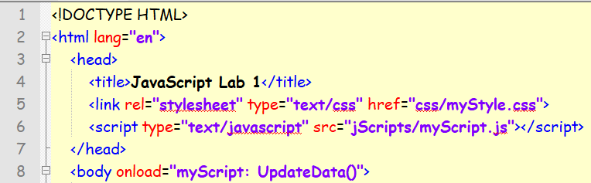
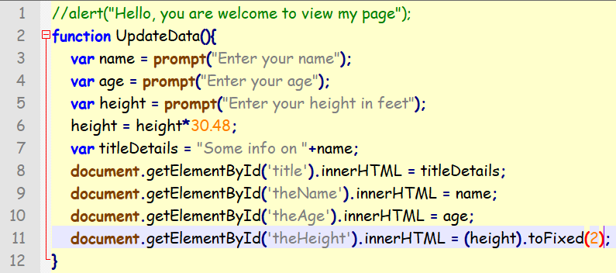
External JavaScript

Slide 14
CSS Styling
Based on observations and questions from students about their projects I have decided to incorporate the answers into this lab as a form of revision. The styling will be demonstrated at the start of the lab
Use the resources available to you from the W3C school.
I have provided some code snippets on the following page to help you
If you get stuck or have questions about any part of this lab – Please ask

Slide 15
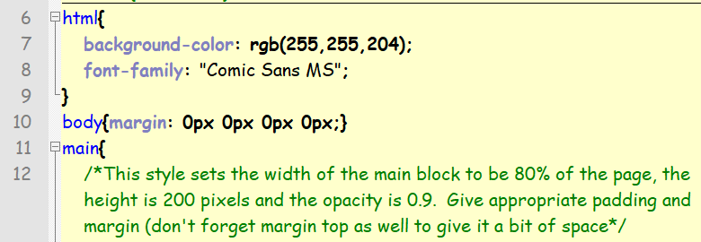
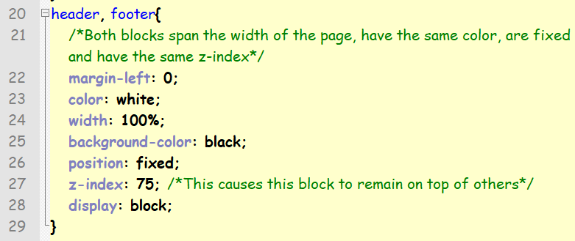

Slide 16
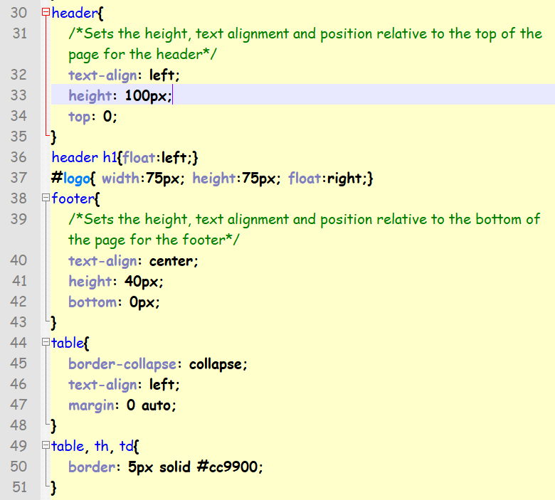

Slide 17
Errors in your code & how to find them.
This will be covered next week

